Slide 1
North Bay 2M Critical Mass October 18, 2020
Topics
Zoom – Be an Effective Host or Attendee Brian Cooley
ACP 125 (What does it mean to us) Milt Hyams
Use and Setting of Reverse on Your Radio Steve Toquinto
Elmer Time All

Slide 2
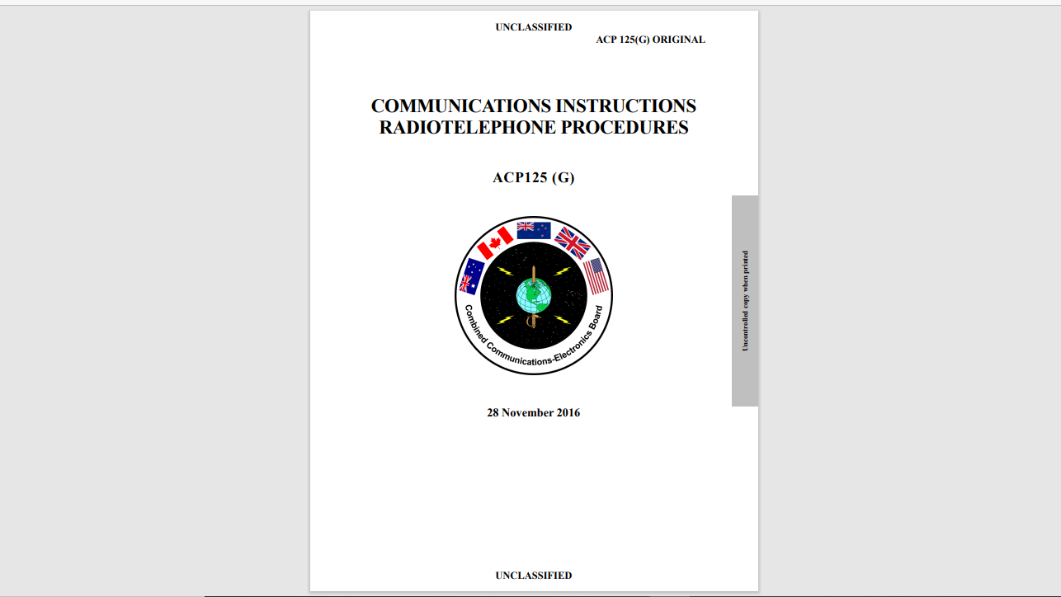
Allied Communications Procedures ACP 125 (G)

Slide 3
PURPOSE OF ACP 125
ACP 125 prescribes the voice procedure for use by the armed forces of Allied nations on secure and non-secure tactical voice nets. Its purpose is to provide a standardized way of passing speech and data traffic as securely as possible consistent with accuracy, speed and the needs of command and control. To ensure interoperability, ACP 125 procedures are to form the foundation of all national or single-service radiotelephone procedure doctrine.

Slide 4
WHO PUBLISHES ACP 125
The Combined Communications-Electronics Board (CCEB) comprised of the five member nations, Australia, Canada, New Zealand, United Kingdom and United States and is the Sponsoring Authority for all Allied Communications Publications (ACPs). ACPs are raised and issued under common agreement between the member nations.

Slide 5
WHAT IS IN IT?
CH 1 – introduction (includes voice procedure)
CH 2 – Security
CH 3 – Accuracy (key chapter re speech techniques includes tables for phonetic alphabet and pronunciation, figure pronunciation, prowords and standard abbreviations)
CH 4 – Discipline
CH 5 – Messages
CH 6 – Operating Rules (includes net ops, radio checks, msgs)
CH 7 – Executive Method
CH 8 – Miscellaneous Procedures (Includes synching time)
CH 9 – Procedures for Reporting Enemy Contacts

Slide 6
WHY IS IT IMPORTANT TO AMATEUR RADIO
Many features such as phonetic alphabet, pro words and net procedures have be adopted by:
Foundation of all national or single-service radiotelephone procedure doctrine, including:
Civil aviation
Homeland Security (Office of Emergency Comm)
FEMA (ICS with modifications and extensions)
Elements used by hams internationally

Slide 7
E-Mail Attachment ACP 125 F Abbreviated
An extract of ACP125 F (from an earlier version of ACP 125)
Handout given to non-operator trainees (can be found on internet)
Includes items you should know (+ military examples of procedures)

Slide 8
METHOD OF SPEECH
The key words to remember are Rhythm, Speed, Volume and Pitch (RSVP):
Rhythm. Use short sentences divided into sensible phrases which maintain a natural rhythm; they should not be spoken word by word. Where pauses occur, the press-to-talk should be released to minimize transmission time and permit stations to break in when necessary.
Speed. Speak slightly slower than for normal conversation. Where a message is to be written down by the recipients, or in difficult conditions, extra time should be allowed to compensate for the receiving station experiencing the worst conditions. Speed of transmission is easily adjusted by increasing or decreasing the length of pauses between phrases, as opposed to altering the gaps between words; the latter will create an unnatural, halted style of speech, which is difficult to understand.
Volume. Speak quietly when using whisper facilities, otherwise the volume should be as for normal conversation. Shouting causes distortion.
Pitch. The voice should be pitched slightly higher than for normal conversation to improve clarity

Slide 9
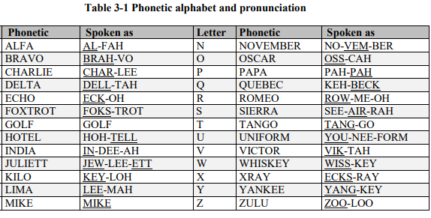

Slide 11
RULES FOR SPELLING
Proword: “I spell”
Say word before and after spelling (exception: don’t try to pronounce unpronounceable words or acrronyms)
Don’t try to spell abbreviations i.e. ETA, RV, FM (speak abbreviation or spell full words)
Numbers, Proword: “Figures”
Mixed: Spoken as ACP 1-2-5 “I SPELL Alpha Charlie Papa Figures one two five”

Slide 12
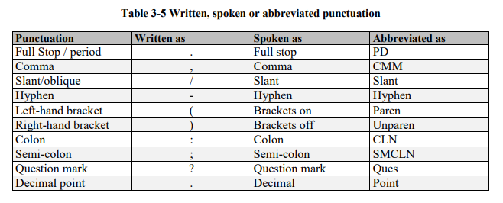

Slide 13
RADIO DISCIPLINE
Radio discipline is a fundamental ingredient of voice procedure without which a radio net cannot function efficiently. Inadequate radio discipline reduces communications efficiency and accuracy.
Especially critical in public service events.

Slide 14
PUNCTUATION RULES
If punctuation is other than those listed they are to be written in full and spoken as such (i.e. apostrophe, quote, etc.)
Punctuation is not used unless necessary to sense of message.
Rarely required where originator makes own transmission.
EXCEPTION: Voice transmission of formal message (i.e. ICS 213) where distribution is beyond the immediate recipient of the message.

Slide 15
PROCEDURE WORDS
Procedure words (PROWORDS). To keep voice transmissions as brief and clear as possible standard prowords are used in place of whole sentences. Prowords are easily pronounced and recognized words or phrases used to convey a specific predetermined meaning, for example: ROGER, OUT.
PROSIGNS are authorized abbreviations of prowords, OPSIGS are three letter civil (Q) and military (Z) codes used for a wide range of communications purposes. Both prosigns and OPSIGS should be used to expedite radio logging.
Annex A to CH 3 contains the Prowords, Prosigns and OPSIGS relevant to radiotelephone procedures. (See e-mail attachment for amateur version of Prowords.)

Slide 16
RADIO DISCIPLINE RULES
The following rules for radio discipline are mandatory on all radio nets. Every station must adhere to the following-- Always:
Use correct voice procedure.
Maintain a constant listening radio watch unless specific instructions or permission has been received to the contrary. This requires that at least one person be nominated to monitor the radio regardless of the circumstances. All aspects of voice procedure are based on the assumption that stations will respond to the call immediately.
Ensure that the correct frequency is in use.
Answer calls in the correct order and without delay.
Listen carefully before transmitting to ensure that the frequency is clear and, where possible allow for stations which cannot be heard.
Release the press-to-talk switch promptly.
On releasing the press-to-talk switch, ensure that the radio returns to the receive condition.

Slide 17
OPERATING RULES
To use net time more efficiently, all messages or their substance should be written down prior to transmission.
Those messages which must be delivered by the receiving operator to another person, or which are preceded by the proword MESSAGE, shall be written down.
Transmissions by radiotelephone shall be as short and concise as practicable, consistent with clarity. Long Message Procedure is required to reduce time spent on the air and allow another station to break in with precedence traffic if required. Transmission length should be no longer than 20 seconds in any one transmission.
Radiotelephone transmissions should be clear, with natural emphasis on each word except the prescribed pronunciation of a numeral, and should be spoken in natural phrases, not word by word.
To avoid interfering with other traffic, an operator shall listen to make certain that a net is clear before making any transmission.
When it is necessary either for the adjustment of a transmitter before making a call or for the adjustment of a receiver, test signals will not continue for more than 10 seconds and will be composed of spoken numerals (1, 2, 3 etc.) followed by the call sign of the station transmitting the signals.

Slide 18
RADIO CHECKS, SIGNAL STRENGTH AND READABILITY
A station is understood to have good signal strength and readability unless otherwise notified. Strength of signals and readability will not be exchanged unless one station cannot clearly hear another station.
A station that wishes to inform another of his signal strength and readability will do so by means of a short and concise report of actual reception such as, WEAK BUT READABLE, LOUD BUT DISTORTED, WEAK WITH INTERFERENCE, etc. Reports such as “five by five,” “four by four,” etc., will not be used to indicate strength and quality of reception.

Slide 19
RADIO CHECK RESPONSES
The prowords below are for use when initiating and answering queries concerning signal strength and readability:
RADIO CHECK. What is my signal strength and readability; how do you hear me?
ROGER. I have received your last transmission satisfactorily. The omission of comment on signal strength and readability is understood to mean that reception is loud and clear.
If reception is other than loud and clear, it must be described with the prowords on next slide.
NOTHING HEARD. To be used when no reply is received from a called station.

Slide 20
SIGNAL REPORT PROWORDS
Signal Strength
Loud
Good
Weak
Very Weak
Fading
Readability
Clear
Readable
Unreadable
Distorted
With Interference
Intermittent

Slide 21
BREAK-IN PROCEDURE
A station having a message of higher precedence than transmission in progress may break in and suspend that transmission in the following circumstances:
FLASH. Break in at once and transmit the message repeating the precedence three times.
IMMEDIATE. May break in at once and pass the message. A preliminary call may be made before transmitting the message, if necessary. On a directed net, approval to transmit the message must be obtained.
PRIORITY. As for IMMEDIATE except that only long ROUTINE messages should be interrupted.

Slide 22
SYNCHRONIZING TIME
If an accurate time check is desired, it will be requested by using the phrase “Request time check.”
The time at which the check is required may be indicated by the addition of a four-figure group.
Time checks will be given in Greenwich Mean Time (GMT aka ZULU Time) unless otherwise requested or directed. (If local time, add suffix Lima to four figure group.)

